Slide 1




Github Link
https://github.com/CheersMeMe/CheersMeMe
GROUP NAME: Cheeris
1.INGABIRE MUGENZI Mireille
2.GASOMINALI Olivier
3.NIYOMUGABO Olivier
4.UWANYAGASANI Jerome
5.UWISIBO Jean Tresor
6.HABIMANA Janvier

Slide 2
Idea
The unawareness of locals and foreigners using transport in the country.98% of people around Kigali and other places , they are unaware of their means of transport available at time. Many people complains , Face difficulties moving around using private and public transport especially foreigners and locals .

Slide 3
Idea continue
Increasing the number of people using their public and private transport when they are aware of the requirements needed in their journey
We created a website :www.memetransport.com that briefly provides all necessary requirements for one to begin and end a journey happy and aware. People can access all information on the web concerning the types of transport , amount to pay , booking tickets, code numbers on buses, kilometers taken in journey and pictures of the place and all means of transport available in the local areas of interest.

Slide 4
Business Case
.Linking website with travelling agencies(RFTC,KBS, Tourist travel agencies).Making website public by giving brief details for local and foreigners, Through adververts and links from social media for live chat with clients.
.It will increase full awareness of clients in need of transport services details. With this web it will increase in and outside tourism ,it increase more number of satisfied clients It helps clients to save their time and help them to book their tickets using mobiles phone , it will save environments and improve the security of the clients money.

Slide 5
Business case continue
.Users values will be realized when they join the web through login , Live chats, sign up using social media(WhatsApp and Facebook messenger) and website link and also on e-mails for weekly update.
. This projects can be monetized when clients login ,sign up to book tickets online and through travel agencies in indeed of this profitable website .

Slide 6
Technology
The JavaScript SDK on the website, Photoshop mockup creation, editors:-Atom and subline, database tools: -xamp control panel and MySQL server and the Browser: Google and internet explorer

Slide 7
Experience
Working hand in hand with travel agencies, and we will collaborate with a company that will facilitate in online tickets payment using banks , mobile money, visa card, pay pal , master card , MPessa( Kenya and Uganda).
Basic knowledge on internet

Slide 8

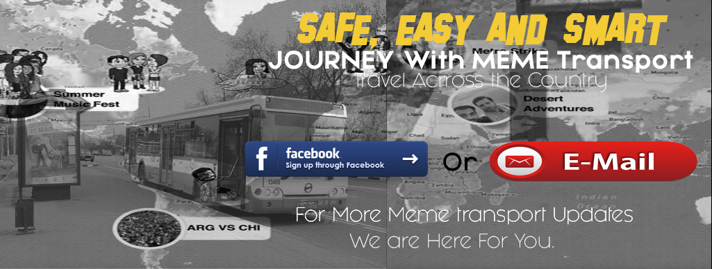
Home
Discover
Contact Us
About Us

Slide 9


Home
Discover
Contact Us
About Us
Let's Chat – Online
Meme Transport Powered by Cheeris Group-2018

Slide 10
Home
Discover
Contact Us
About Us
Let's Chat – Online
Email:
Example@gmail.com
Suggestion:
Your Suggestion Here
Send
Meme Transport Powered by Cheeris Group-2018

Slide 11
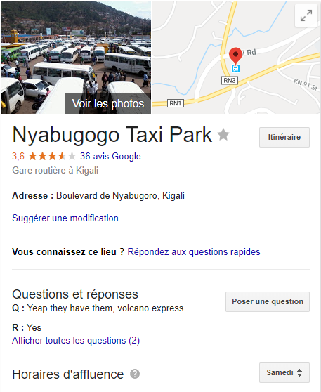
Home
Discover
Contact Us
About Us
MAP BUS Station
Simply because there are much bus station in country you may Map all the around bus station
With different transportation companies so you that you may
Know which company you will use to travel anywhere at what time
Where is the bus station accordingly to the generated image
Simply the pricing plan for any journey or travel is fixed there
So MEME Transport we are here for you. any question contact us
MORE DETAILS
Let's Chat – Online
Meme Transport Powered by Cheeris Group-2018

Slide 12
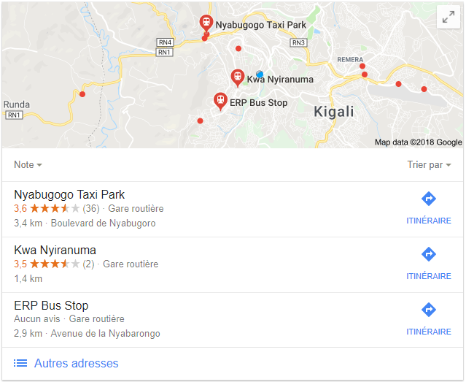
Home
Discover
Contact Us
About Us
NEARBY BUS Stations
Simply because there are much bus station in country you may Map all the around bus station
With different transportation companies so you that you may
Know which company you will use to travel anywhere at what time
Where is the bus station accordingly to the generated image
Simply the pricing plan for any journey or travel is fixed there
So MEME Transport we are here for you. any question contact us
MORE DETAILS
Let's Chat – Online
Meme Transport Powered by Cheeris Group-2018

Slide 13
Home
Discover
Contact Us
About Us
SIGN UP WITH YOUR FACEBOOK ACCOUNT FOR MEME Transport Updates
Field with * is required
Names*:
Full Name Here
Email*:
Example@gmail.com
Password*:
Full Name Here
I have read and accept term and condition for Meme transport
Sign Up
Let's Chat – Online
Meme Transport Powered by Cheeris Group-2018

Slide 14
Thank You

